Slide 1
A Case for Speculative Address Translation with Rapid Validation for GPUs
Junhyeok Park¹ Osang Kwon¹ Yongho Lee¹
Seongwook Kim¹ Gwangeun Byeon¹ Jihun Yoon¹ Prashant J. Nair² Seokin Hong¹
¹
²

Slide 2
Outline
1. Virtual Memory in GPUs – Challenges ☜
2. Avatar • Speculative address translation • Rapid Validation
3. Evaluation
4. Summary
1

Slide 3
GPUs in Heterogeneous Platform
CPU
GPU
GPU
HBM
GDDR
CPU Memory
~X TB
GPU Memory
~XX GB
GPU Memory
~XX GB
2

Slide 4
GPUs in Heterogeneous Platform
CPU
GPU
GPU
Unified Memory space
➊ Seamless data sharing ➋ Efficient memory management
Virtual Memory
HBM
GDDR
Virtual Memory
CPU Memory
~X TB
GPU Memory
~XX GB
GPU Memory
~XX GB
2

Slide 5
Address Translation in GPUs
GPU Core
L1 TLB
L1 Cache
L1 TLB
GPU
Shared
L2 TLB
L2 Cache
Shared
L2 TLB
Page walker
GPU Main Memory
Page walker
Page walker
Page walker
3

Slide 6
Address Translation in GPUs
VIPT Cache
Memory Request
GPU Core
L1 TLB
L1 Cache
L1 TLB
Miss
L1 TLB
L1 Cache
GPU
Shared
L2 TLB
L2 Cache
Shared
L2 TLB
Miss
Page walker
Shared L2 TLB
L2 Cache
Page walker
GPU Main Memory
Page walker
Page walker
Page Walker
GPU Main Memory
Address Translation Overhead
Look up
L1 TLB miss
L2 TLB miss
L1 TLB •
L1 Cache
L2 TLB • Page Walk
4

Slide 7
Address Translation in GPUs
VIPT Cache
Memory Request
GPU Core
L1 TLB
L1 Cache
L1 TLB
Miss
Miss
L1 TLB
L1 Cache
GPU
Shared
L2 TLB
L2 Cache
Shared
L2 TLB
Miss
Miss
Page walker
Shared L2 TLB
L2 Cache
Page walker
GPU Main Memory
Page walker
Page walker
Page Walker
GPU Main Memory
Address Translation Overhead
TLB Hit!!
L1 Cache miss
Look up
L1 TLB miss
L2 TLB miss
Replay
L2 Cache miss
Replay
Return
L1 TLB •
L1 Cache
L2 TLB • Page Walk
L1 TLB •
L1 Cache
L2 Cache • Memory
L1 TLB •
L1 Cache
4

Slide 8
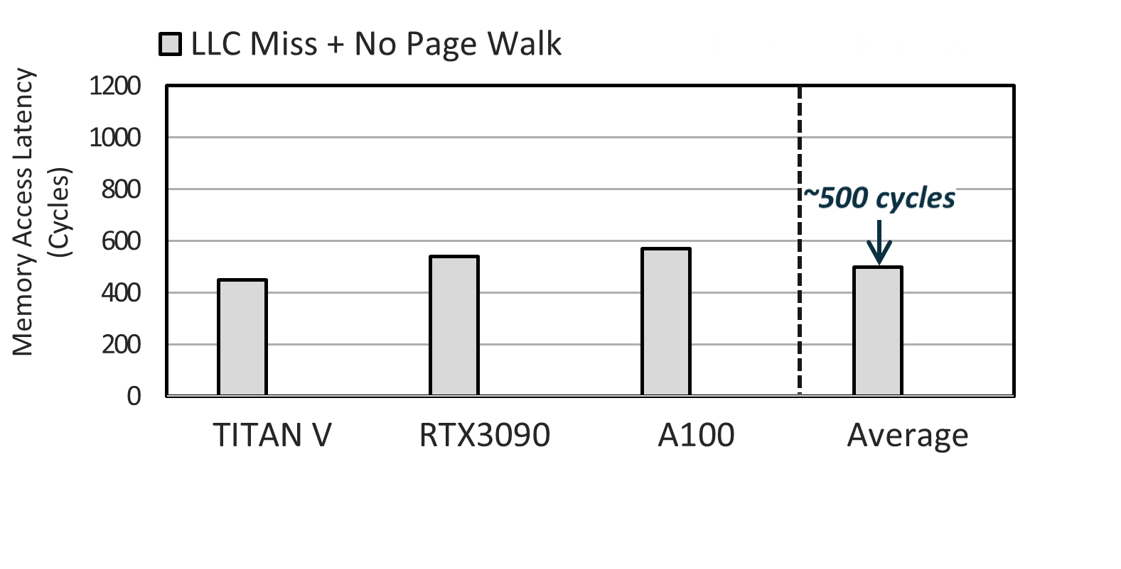
Address Translation in GPUs
Memory access latency considering address translation overhead
5

Slide 9
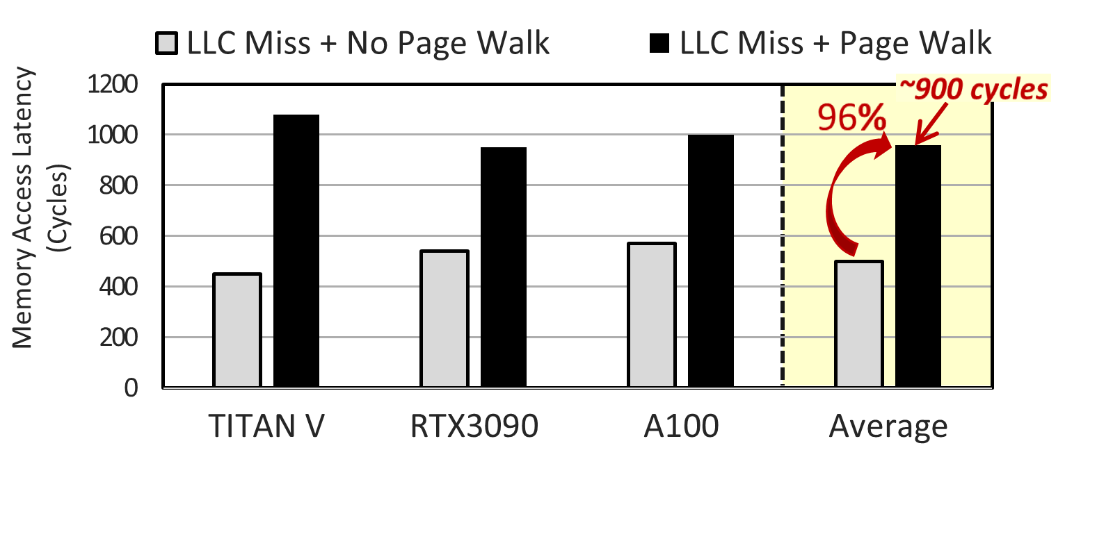
Address Translation in GPUs
Address translation (page walk) increase memory access latency up to 1.96x
5

Slide 10
Address Translation in GPUs
Address translation (page walk) increase memory access latency up to 1.96x
Needs efficient address translation support for GPUs
5

Slide 11
Outline
1. Virtual Memory in GPUs – Challenges
2. Avatar ☜ • Speculative address translation • Rapid Validation
3. Evaluation
4. Summary
7

Slide 12
Avatar
Accelerated Virtual Address Translation with Address Speculation and Rapid Validation
Speculative Address Translation
Rapid Validation
for speculation
Return to GPU core
L1 TLB •
L1 Cache
L2 TLB • Page Walk
L1 TLB •
L1 Cache
L2 Cache • Memory
L1 TLB •
L1 Cache
L1 TLB •
L1 Cache
L2 Cache • Memory
L1 TLB •
L1 Cache
Saved
Our Goal
8

Slide 13
Avatar
Accelerated Virtual Address Translation with Address Speculation and Rapid Validation
Speculative Address Translation
Rapid Validation
for speculation
➊ How to speculate?
Return to GPU core
L1 TLB •
L1 Cache
L2 TLB • Page Walk
L1 TLB •
L1 Cache
L2 Cache • Memory
L1 TLB •
L1 Cache
➋ How to validate rapidly?
L1 TLB •
L1 Cache
L2 Cache • Memory
L1 TLB •
L1 Cache
Saved
Our Goal
8

Slide 14
Outline
1. Virtual Memory in GPUs – Challenges
2. Avatar • Speculative address translation ☜ • Rapid Validation
3. Evaluation
4. Summary
9

Slide 15
Speculative Address Translation
How to speculate?
➊ Key Observation
➋ Implementation: CAST
10

Slide 16
Speculative Address Translation
How to speculate?
➊ Key Observation
➋ Implementation:
CAST
10

Slide 17
Key Observation – Page Contiguity
Memory Management in Unified Memory
CPU memory
GPU memory
CPU
Page 1
GPU
Page 2
Unified Memory space
11

Slide 18
Key Observation – Page Contiguity
Memory Management in Unified Memory
CPU memory
GPU memory
Page fault
CPU
Page 1
GPU
Page 2
Unified Memory space
11

Slide 19
Key Observation – Page Contiguity
Memory Management in Unified Memory
CPU memory
GPU memory
CPU
Page 1
GPU
Page migration
Page 2
Unified Memory space
11

Slide 20
Key Observation – Page Contiguity
Leveraging 2MB page contiguity
Virtual
address space
GPU physical
address space
Classify fault
by 2MB VA
2MB virtual chunk
VPN 0x000
VPN 0x001
Page 1
2MB
physical chunk
PPN 0x100
VPN 0x1FF
VPN 0x002
Page 2
VPN 0x2FF
2MB physical space
reserved
12

Slide 21
Key Observation – Page Contiguity
Leveraging 2MB page contiguity
Virtual
address space
GPU physical
address space
GPU page table
Classify fault
by 2MB VA
VPN 0x000
VPN 0x000 VPN 0x001 PPN 0x101
VPN 0x002 PPN 0x102
VPN 0x003
0x001
· · · ·
0x002
VPN 0x001
Page 1
PPN 0x100
VPN 0x1FF
0x101
0x102
VPN 0x002
Page 2
VPN 0x2FF
2MB physical space
reserved
12

Slide 22
Key Observation – Page Contiguity
VA space
GPU page table
· · · ·
VPN 0x000 PPN 0x100 VPN 0x001 PPN 0x101
VPN 0x002 PPN 0x102
VPN 0x003
VPN 0x004 PPN 0x104
· · · ·
· · · ·
PA space
Page contiguity :
contiguous virtual addresses are mapped to contiguous physical addresses,
particularly within each 2MB region
13

Slide 23
Exploiting Page Contiguity for Speculation
GPU page table
V2P Offset
➊
VPN 0x000 PPN 0x100 VPN 0x001 PPN 0x101
VPN 0x002 PPN 0x102
VPN 0x003
VPN 0x004 PPN 0x104
➋ - ➊ = 0x100
➋
· · · ·
➊
➋
➋ - ➊ = 0x100
Contiguous region maintains the same virtual-to-physical (V2P) offset
14

Slide 24
Exploiting Page Contiguity for Speculation
GPU page table
V2P Offset
➊
VPN 0x000 PPN 0x100 VPN 0x001 PPN 0x101
VPN 0x002 PPN 0x102
VPN 0x003
VPN 0x004 PPN 0x104
VPN 0x103 PPN ???
➋ - ➊ = 0x100
➋
· ·
Contiguous region maintains the same virtual-to-physical (V2P) offset
14

Slide 25
Exploiting Page Contiguity for Speculation
GPU page table
V2P Offset
➊
VPN 0x000 PPN 0x100 VPN 0x001 PPN 0x101
VPN 0x002 PPN 0x102
VPN 0x003
VPN 0x004 PPN 0x104
VPN 0x103 PPN ???
➋ - ➊ = 0x100
➋
· ·
VPN + V2P Offset = PPN
0x103 + 0x100 = 0x203
Speculates the PPN!!
Contiguous region maintains the same virtual-to-physical (V2P) offset
14

Slide 26
Speculative Address Translation
How to speculate?
➊ Key Observation
➋ Implementation:
CAST
15

Slide 27
Speculative Address Translation
How to speculate?
➊ Key Observation
➋ Implementation:
CAST
15

Slide 28
CAST: Contiguity-Aware Speculative Translation
GPU page table
Request 1 (PC 0x01)
VPN 0x000 PPN 0x100 VPN 0x001 PPN 0x101
VPN 0x002 PPN 0x102
VPN 0x003
VPN 0x004 PPN 0x104
VPN 0x1FF PPN 0x2FF
V2P Offset= 0x100
· ·
Request 2 (PC 0x01)
V2P Offset= 0x100
➊ The same load instructions
likely touch a contiguous region
16

Slide 29
CAST: Contiguity-Aware Speculative Translation
GPU page table
Mapping Offset Detection Table
Request 1 (PC 0x01)
VPN 0x000 PPN 0x100 VPN 0x001 PPN 0x101
VPN 0x002 PPN 0x102
VPN 0x003
VPN 0x004 PPN 0x104
VPN 0x1FF PPN 0x2FF
V2P Offset= 0x100
PC | State count | V2P Offset
0x03
0x01 | 0 →1 →2 | 0x100
0x05
· ·
Request 2 (PC 0x01)
V2P Offset= 0x100
➊ The same load instructions
likely touch a contiguous region
➋ MOD table tracks V2P offset for each load instructions
16

Slide 30
CAST: Contiguity-Aware Speculative Translation
Load Request
Miss
L1 TLB
L1 Cache
CAST
MOD
17

Slide 31
CAST: Contiguity-Aware Speculative Translation
TLB miss request
VPN
Page Offset
Mapping Offset Detection Table
Load Request
PC | State count | V2P Offset
0x03
0x01 | 2 | 0x100
0x05
Miss
PC: 0x01 | 0x002 | 0x300
L1 TLB
L1 Cache
CAST
MOD
Enable
≥threshold?
+ .
Speculated PPN
Page Offset
Speculated Physical Address
0x102 | 0x300
17

Slide 32
Outline
1. Virtual Memory in GPUs – Challenges
2. Avatar • Speculative address translation • Rapid Validation ☜
3. Evaluation
4. Summary
18

Slide 33
Rapid Validation
How to validate rapidly?
➊ Prior Approach • Lazy validation
➋ Our Approach
• Key observation • Implementation:
CAVA
19

Slide 34
Rapid Validation
How to validate rapidly?
➊ Prior Approach • Lazy validation
➋ Our Approach
• Key observation • Implementation:
CAVA
19

Slide 35
Limitation in Prior Approach
Lazy validation for speculative translation in CPUs
Speculative address translation
Look up
L1 Cache miss
L1 TLB • L1 Cache
L2 Cache • Memory
L2 TLB • Page Walk (Background)
L1 TLB miss
20

Slide 36
Limitation in Prior Approach
Lazy validation for speculative translation in CPUs
Speculative address translation
Look up
L1 Cache miss
Speculative Execution
Normal Execution
L1 TLB • L1 Cache
L2 Cache • Memory
L2 TLB • Page Walk (Background)
L1 TLB miss
Validation – Correct Speculation
20

Slide 37
Limitation in Prior Approach
Speculative address translation
Look up
L1 Cache miss
Speculative Execution
Rollback
Normal Execution
L1 TLB • L1 Cache
L2 Cache • Memory
Penalty
L2 TLB • Page Walk (Background)
L1 TLB miss
Validation – Incorrect Speculation
Limitation ➊: Expensive roll-back process
21

Slide 38
Limitation in Prior Approach
Speculative address translation
Look up
L1 Cache miss
Speculative Execution
Rollback
Normal Execution
L1 TLB • L1 Cache
L2 Cache • Memory
L2 TLB • Page Walk (Background)
L1 TLB miss
Validation – Incorrect Speculation
Limitation ➋: GPUs do not even support rollback mechanisms
22

Slide 39
Limitation in Prior Approach
Speculative address translation
Look up
L1 Cache miss
Execution
Waiting
L1 TLB • L1 Cache
L2 Cache • Memory
Penalty
L2 TLB • Page Walk (Background)
L1 TLB miss
Validation
Simple Solution: To wait for validation to complete
23

Slide 40
Rapid Validation
How to validate rapidly?
➊ Prior Approach • Lazy validation
➋ Our Approach
• Key observation • Implementation:
CAVA
24

Slide 41
Rapid Validation
How to validate rapidly?
➊ Prior Approach • Lazy validation
➋ Our Approach
• Key observation • Implementation:
CAVA
24

Slide 42
Key Observation – Memory Compression
Compresses each 32-byte sector to 22 bytes (BPC Compression [Kim+, ISCA’16])
*sector: the basic data fetch unit in modern GPUs
On average, 67.5% of sectors can be compressed to 22 bytes
25

Slide 43
CAVA: In-Cache Validation
Embedding page information within data for validation
Data (32B)
Compressed data (22B)
Remaining region (10B)
26

Slide 44
CAVA: In-Cache Validation
Embedding page information within data for validation
Data (32B)
Compressed data (22B)
Page information
(VPN + Permissions)
26

Slide 45
CAVA: In-Cache Validation
GPU
CPU
Memory Controller
GPU driver
CPU Memory
Data page
Data page
GPU Memory
Data page
Data page
27

Slide 46
CAVA: In-Cache Validation
GPU
CPU
Memory Controller
GPU driver
Data page
Page information
CPU Memory
Data page
GPU Memory
Data page
Data page
The page information (VPN + permissions) is transferred with the data page
27

Slide 47
CAVA: In-Cache Validation
GPU
CPU
Memory Controller
Page information
Data page
GPU driver
Page information
sector
Compressor
Compressed Sector
CPU Memory
Data page
GPU Memory
Data page
Data page
27

Slide 48
CAVA: In-Cache Validation
GPU
CPU
Memory Controller
Page information
Data page
GPU driver
Page information
Compressor
Compressed Sector
Sector
CPU Memory
Data page
GPU Memory
Data page
Data page
27

Slide 49
CAVA: In-Cache Validation
GPU
CPU
Memory Controller
GPU driver
Page information
Data page
Compressor
Compressed Sector
CPU Memory
Data page
GPU Memory
Data page
Data page
Sector
Sector
Sector
Sector
Compression status distinction [Hong+, MICRO’18]
Page information
Signature (2B) | VPN + Permissions (8B) | Compressed data (22B)
27

Slide 50
Saved (➊ + ➋)
CAVA: In-Cache Validation
Load Request
➊ Speculation with CAST
Miss
L1 TLB
L1 Cache
CAST
➋ Data fetched from the speculated address
➊
MOD
L2 Cache
L2 TLB
➋
➌ Address translation in the background
GPU Main Memory
Page Walker
➌
28

Slide 51
CAVA: In-Cache Validation
Load Request
C: a compression bit in each sector tag
C
Sector 0
C
Sector 1
C
Sector 2
C
Sector 3
Miss
L1 TLB
L1 Cache
CAVA
L2 Cache Fill
CAST
Check whether sector is compressed
Compressed?
MOD
L2 Cache
signature
L2 TLB
GPU Main Memory
GPU Memory
Page Walker
Sector
Sector
Sector
Sector
29

Slide 52
CAVA: In-Cache Validation
Load Request
Can be used
L1 Cache
Miss
L1 Cache
Data
L1 TLB
L1 Cache
CAVA
CAST
Memory request information in MSHR
MOD
Decompress
VPN: 0x002
= .
L2 Cache
VPN | PPN | Sector
0x002 | 0x102 | 0
L2 TLB
C
Sector 0
GPU Main Memory
Page Walker
Fetch into L1 Cache
30

Slide 53
Timeline Comparison
L1 TLB •
L1 Cache
L2 TLB • Page Walk
L1 TLB •
L1 Cache
L2 Cache • Memory
L1 TLB •
L1 Cache
Baseline
L1 TLB • L1 Cache
L2 Cache • Memory
Waiting
L1 TLB •
L1 Cache
Saved
L2 TLB • Page Walk (Background)
➊ Speculation + No Rapid Validation (CAST)
31

Slide 54
Timeline Comparison
L1 TLB •
L1 Cache
L2 TLB • Page Walk
L1 TLB •
L1 Cache
L2 Cache • Memory
L1 TLB •
L1 Cache
Baseline
L1 TLB • L1 Cache
L2 Cache • Memory
Waiting
L1 TLB •
L1 Cache
Saved
L2 TLB • Page Walk (Background)
➊ Speculation + No Rapid Validation (CAST)
L1 TLB • L1 Cache
L2 Cache • Memory
L1 TLB •
L1 Cache
Saved
L2 TLB • Page Walk (Background)
➋ Speculation + Rapid Validation (CAST + CAVA)
31

Slide 55
Outline
1. Virtual Memory in GPUs – Challenges
2. Avatar • Speculative address translation • Rapid Validation
3. Evaluation ☜
4. Summary
32

Slide 56
Methodology
Simulator: GPGPU-Sim 4.0 [Khairy+, ISCA’20]
▶ Virtual memory support (Unified Memory / 4KB page for baseline)
Avatar Framework:
▶ 32-entry MOD table ▶ Data compression using the Bit-Plane Compression method [Kim+, ISCA’16]
Component | Parameter
L1 TLB | 32 entries (4KB), 16 entries* (2MB)
L2 TLB | 1024 entries (4KB), 128 entries* (2MB)
Page walk | 16 page walkers
* 2MB TLBs for page size promotion
33

Slide 57
Methodology
Workloads: 20 applications from various benchmark suites
▶ Diverse data types ▶ Classified on TLB sensitivity
Comparison to Prior Works:
▶ Promotion [Ausavarungnirun+, MICRO’17]: Page size promotion ▶ CoLT [Pham+, MICRO’12]: Fixed-size TLB coalescing
▶ SnakeByte [Lee+, HPCA’23]: Multi-size TLB coalescing
34

Slide 58
Evaluation
Speculation Accuracy - How many speculative translations are correct?
→ 90.3% Speculation Coverage - How many TLB misses are handled by CAST?
→ 74.3%
35

Slide 59
Evaluation
Memory Access Latency Reduction Avatar - 44.5%↓
GPU Core Stall Cycles Reduction Avatar - 45.0%↓
36

Slide 60
Evaluation
Performance Improvement Avatar - 37.2%↑ > Best of prior works - 27.1%↑
37.2%
3.47|4.19|2.91|3.78
TLB-insensitive
TLB-moderate
TLB-sensitive
37

Slide 61
Outline
1. Virtual Memory in GPUs – Challenges
2. Avatar • Speculative address translation • Rapid Validation
3. Evaluation
4. Summary ☜
38

Slide 62
Summary
Problem: Address translation overhead in GPUs (34.5% slower compared to Ideal)
39

Slide 63
Summary
Problem: Address translation overhead in GPUs (34.5% slower compared to Ideal)
Avatar: Speculative address translation overcoming GPUs’ architectural limit
▶ Speculative translation by exploiting page contiguity
▶ Rapid validation using page information embedded within data blocks
39

Slide 64
Summary
Problem: Address translation overhead in GPUs (34.5% slower compared to Ideal)
Avatar: Speculative address translation overcoming GPUs’ architectural limit
▶ Speculative translation by exploiting page contiguity
▶ Rapid validation using page information embedded within data blocks
Avatar achieves an average speed up of 37.2% across various workloads
39

Slide 65
A Case for Speculative Address Translation with Rapid Validation for GPUs
Thanks!
Junhyeok Park¹ Osang Kwon¹ Yongho Lee¹
Seongwook Kim¹ Gwangeun Byeon¹ Jihun Yoon¹ Prashant J. Nair² Seokin Hong¹
¹
²

Slide 66
Backup Slides
• Page Access Pattern of Load
• Security Implications
• Without Rapid Validation
• TLB Shootdown
• ML Workloads
• Workload Categorization
40

Slide 67
Page Access Pattern of Load
On average, 89.0% of memory accesses from the same instruction
fall within a 2MB memory chunk.
89.0%
• Backup Slides

Slide 68
Security Implications
Compression bit
C
G
Sector 0
C
G
Sector 0
C
G
Sector 0
C
G
Sector 0
Cacheline
Guarantee bit
Invisible
Incorrect
Validation
Correct
Invalidates
the sector
Can be used
• Backup Slides

Slide 69
Without Rapid Validation
CAST-only (without rapid validation) achieves a 29.1% speedup.
29.1%
• Backup Slides

Slide 70
TLB Shootdown
❹ Zeroing the memory location where the migrated page was stored
(Invalidate all in-sector page information)
❶ Flush a page’s contents
from the caches
Time
❷ Invalidate the PTE of
the page from the TLBs
(TLB shootdown)
❺ Updates the page tables
❸ Transfer the page’s content to CPU (or other GPUs)
• Backup Slides

Slide 71
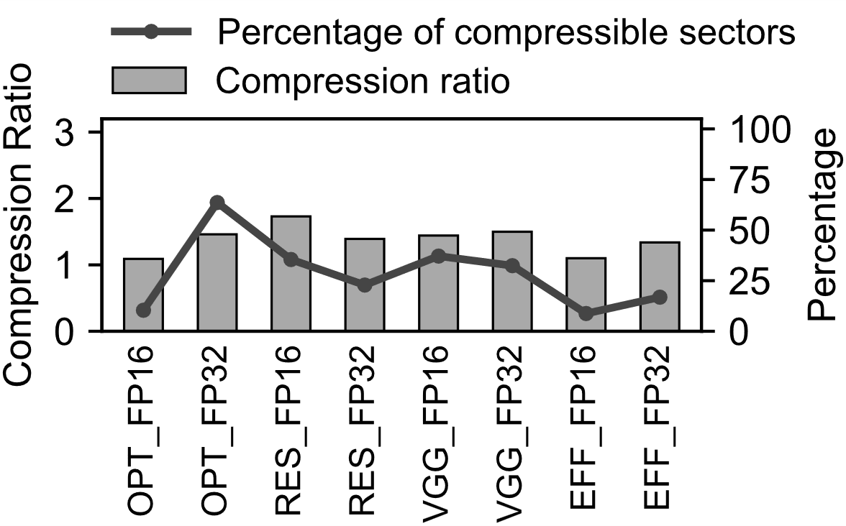
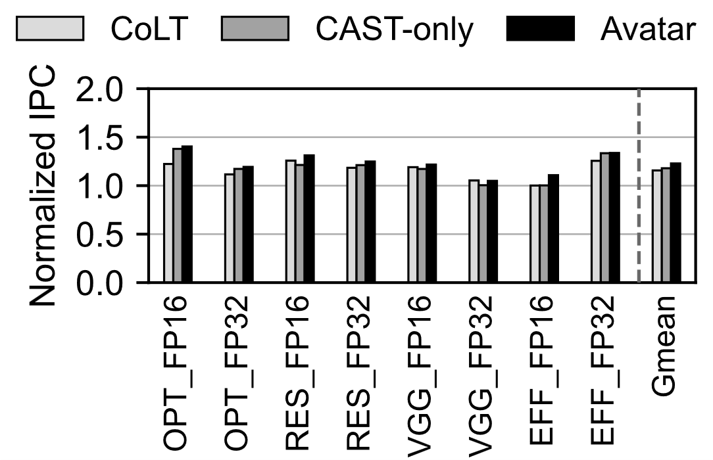
ML Workloads
Avatar outperforms the best prior work by 7.1% on average.
(a) Compressibility
(b) Performance
• Backup Slides

Slide 72
Workload Categorization
Class | Benchmark | Abbr. | Data Type | Benchmark | Abbr. | Data Type
L | fw | FW | I | lavaMD | LMD | D
 | gemm | GEMM | F | sgemm | SGEM | F
M | backprop | BP | F | shoc-MD | MD | I
 | histogram | HIS | UI | pathfinder | PAF | I
H | lulesh | LUL | F | color-max | GC | I
 | fdtd2d | FDT | F | betweenness | BET | UI
 | convolution | CON | F | cfd | CFD | F
 | sssp | SSSP | I | spmv | SPMV | I/F
 | connected | CC | UI | s.cluster | SC | F
 | kmeans | KM | F | XSBench | XSB | I/D
* Denoted as I/UI/F/D for int/unsigned int/float/double
• Backup Slides

