Slide 1


Leveraging Chiplet-Locality for Efficient
Memory Mapping in Multi-Chip Module GPUs
58th IEEE/ACM International Symposium on Microarchitecture
Junhyeok Park^{1, 2} Sungbin Jang² Osang Kwon²
Yongho Lee² Seokin Hong²
¹ETRI ²Sungkynkwan University

Slide 2
Outline
Background: Multi-Chip Module GPUs
Motivations & Goal
Chiplet-Locality Aware Page Placement
Evaluation & Summary
1

Slide 3
Outline
Background: Multi-Chip Module GPUs
Motivations & Goal
Chiplet-Locality Aware Page Placement
Evaluation & Summary
2

Slide 4
Scaling Monolithic GPU Designs
GPU scaling trends in monolithic GPU designs (compute & memory)
 | Tesla K40 (2013) | Tesla M40 | Tesla P100 | Tesla V100 | Ampere A100 | Hopper H100 (2022)
Compute Unit Count | 15 | 24 | 56 | 80 | 108 | 114
L2 Cache Size (MB) | 1.5 | 3 | 4 | 6 | 40 | 50
3

Slide 5
Scaling Monolithic GPU Designs
Monolithic GPU scaling is becoming challenging!
  GPU die size plateaus
  Transistor scaling slows down
 | Tesla K40 | Tesla M40 | Tesla P100 | Tesla V100 | Ampere A100 | Hopper H100
GPU Die Size (mm²) | 551 | 601 | 610 | 815 | 826 | 814
 | 2004 | 2006 | 2008 | 2011 | 2014 | 2015 | 2017 | 2019 | 2020 | 2022 | 2025
Transistor Scaling (nm) | 90 | 65 | 40 | 28 | 20 | 16 | 10 | 7 | 5 | 3 | 2
4

Slide 6
Multi-Chip Module (MCM) GPUs
MCM designs enable continued scaling beyond monolithic designs
Package
DRAM
DRAM
Package
GPU chiplet
GPU chiplet
Monolithic GPU
XBAR
XBAR
MCM
XBAR
XBAR
DRAM
GPU chiplet
GPU chiplet
DRAM
DRAM
5

Slide 7
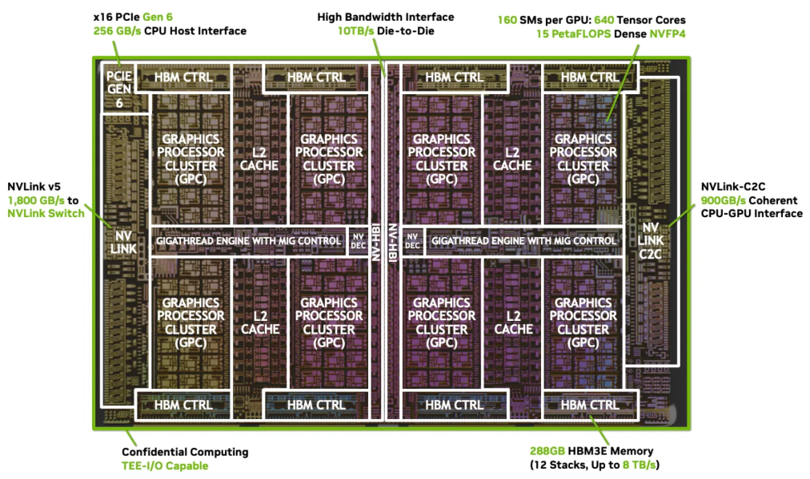
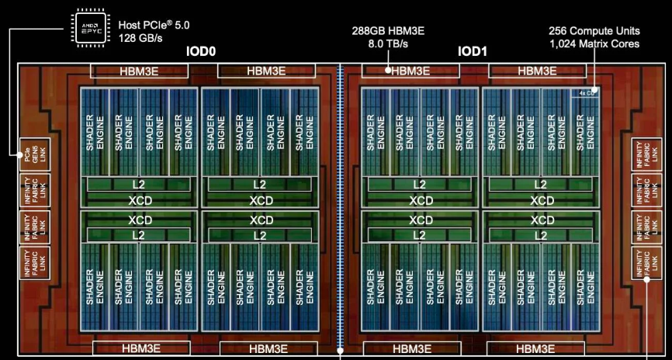
Multi-Chip Module (MCM) GPUs
MCM-based GPU designs are already in use
^{GPU Chiplet}
AMD CDNA 4.0 MI350
NVIDIA Blackwell Ultra GPU
6

Slide 8
Multi-Chip Module (MCM) GPUs: Challenges
Remote memory accesses occur when threads touch remotely mapped data
  Add latency and energy overhead
data
threads
XBAR
XBAR
GPU chiplet
GPU chiplet
DRAM
DRAM
7

Slide 9
Multi-Chip Module (MCM) GPUs: Challenges
Remote memory accesses occur when threads touch remotely mapped data
  Add latency and energy overhead
data
inter-chip interconnect
Remote
Access
threads
XBAR
XBAR
GPU chiplet
GPU chiplet
DRAM
DRAM
8

Slide 10
Outline
Background: Multi-Chip Module GPUs
Motivations & Goal
Chiplet-Locality Aware Page Placement
Evaluation & Summary
9

Slide 11
The Impact of Page Size
Using large pages is generally beneficial
(A) 4KB Pages
Virtual
Address Space
Physical
Address Space
4KB Frame
4KB Page
4KB Page
. . .
4KB Frame
. . . .
4KB Page
4KB Frame
4KB Page
4KB Frame
4KB-Page TLB
Entry 0
Entry 1
Entry 2
Entry 3
10

Slide 12
The Impact of Page Size
Using large pages is generally beneficial
(A) 4KB Pages
(B) 64KB Page
Virtual
Address Space
Physical
Address Space
Virtual
Address Space
Physical
Address Space
4KB Frame
4KB Page
64KB Page
4KB Page
. . .
4KB Frame
. . . .
64KB Frame
4KB Page
Contiguous →
4KB Frame
Contiguous →
4KB Page
4KB Frame
4KB-Page TLB
64KB-Page TLB
Entry 0
Entry 1
Entry 2
Entry 3
Entry 0
11

Slide 13
Larger Pages Can Hurt Performance
Example: memory mapping with small pages (e.g., 4KB)
Data Structure A
threads-0
threads-1
size: 8KB
Chiplet-0
Chiplet-1
XBAR
XBAR
GPU chiplet
GPU chiplet
DRAM
DRAM
12

Slide 14
Larger Pages Can Hurt Performance
Example: memory mapping with small pages (e.g., 4KB)
Data Structure A
threads-0
threads-1
size: 8KB
page 0
page 1
Chiplet-0
Chiplet-1
XBAR
XBAR
GPU chiplet
GPU chiplet
DRAM
DRAM
13

Slide 15
Larger Pages Can Hurt Performance
Example: memory mapping with small pages (e.g., 4KB)
Local Access
threads-0
threads-1
Local Access
Data Structure A
size: 8KB
page 0
page 1
Chiplet-0
Chiplet-1
XBAR
XBAR
GPU chiplet
GPU chiplet
DRAM
DRAM
14

Slide 16
Larger Pages Can Hurt Performance
Example: memory mapping with large pages (e.g., 8KB)
Data Structure A
threads-0
threads-1
size: 8KB
page 0
page 1
Chiplet-0
Chiplet-1
XBAR
XBAR
GPU chiplet
GPU chiplet
DRAM
DRAM
15

Slide 17
Larger Pages Can Hurt Performance
Example: memory mapping with large pages (e.g., 8KB)
Data Structure A
threads-0
threads-1
size: 8KB
page 0’
Chiplet-0
Chiplet-1
XBAR
XBAR
GPU chiplet
GPU chiplet
DRAM
DRAM
16

Slide 18
Larger Pages Can Hurt Performance
Example: memory mapping with large pages (e.g., 8KB)
Local Access
threads-0
threads-1
Data Structure A
size: 8KB
page 0’
Chiplet-0
Remote
Access
Chiplet-1
XBAR
XBAR
GPU chiplet
GPU chiplet
DRAM
DRAM
17

Slide 19
The Impact of Page Size in MCM Designs
Small Pages
- Pros : Enable fine-grained page placement
- Cons: Lower address-translation efficiency
Large Pages
- Pros : Higher address-translation efficiency
- Cons: Enforce coarse-grained page placement
18

Slide 20
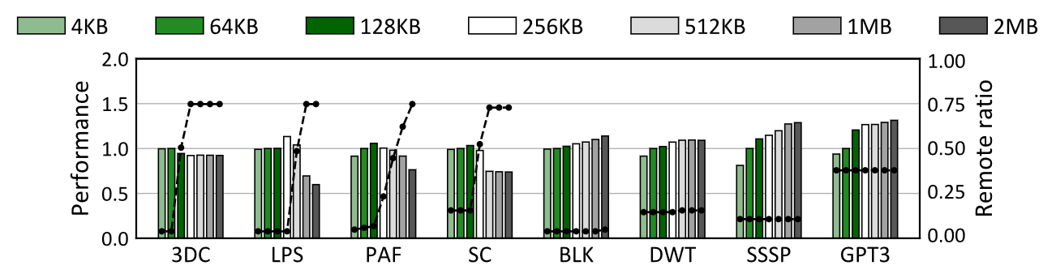
The Impact of Page Size in MCM Designs
Performance across different page sizes
Bars: Performance
Lines: Remote ratio
19

Slide 21

The Impact of Page Size in MCM Designs
Performance across different page sizes
Higher remote ratio
Lower performance
20

Slide 22

The Impact of Page Size in MCM Designs
Performance across different page sizes
Higher performance
Constant remote ratio
21

Slide 23
The Impact of Page Size in MCM Designs
First Motivation:
Each application exhibits different sensitivity to page size changes
22

Slide 24
Chiplet-Locality in GPU Workloads
Second Motivation: Chiplet-Locality
- A certain number of virtually contiguous pages are primarily used by the same chiplet
Virtual
Address Space
Page 0
threads-0
Page 1
Contiguous →
Page 2
Chiplet-0
Page 3
Page 4
Page 5
Page 6
Page 7
threads-1
Chiplet-1
23

Slide 25
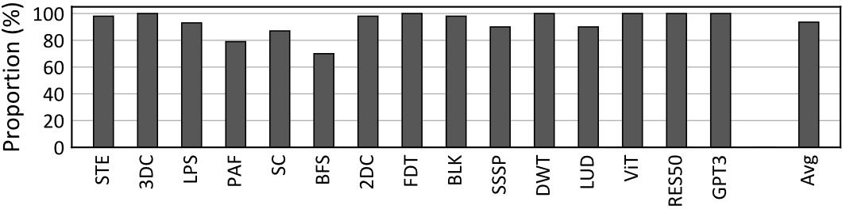
Chiplet-Locality in GPU Workloads
Proportion of the address range exhibiting chiplet-locality
- Chiplet-locality is a prevalent property of GPU workloads
- Arising from the intrinsic characteristics (parallelism) of GPU workloads
93.5%
24

Slide 26
Our Goal
What: Provide the suitable page size (mapping size) for each application, with support
for multiple sizes (Motivation 1)
How: Leverage chiplet-locality, which captures the access patterns of GPU workloads
(Motivation 2)
25

Slide 27
Outline
Background: Multi-Chip Module GPUs
Motivation & Our Goal
Chiplet-Locality Aware Page Placement
Evaluation & Summary
26

Slide 28
Chiplet-Locality Aware Page Placement (CLAP)
What CLAP does
1. Small Pages
2. Large Pages
3. CLAP
GPU page table
chiplet-0
GPU page table
GPU page table
chiplet-0
VPN 0x100 | PFN 0x000
VPN 0x100 | PFN 0x000
VPN 0x100 | PFN 0x000
VPN 0x101 | PFN 0x005
chiplet-0
VPN 0x101 | PFN 0x001
VPN 0x102 | PFN 0x009
VPN 0x102 | PFN 0x002
VPN 0x103 | PFN 0x003
VPN 0x103 | PFN 0x003
VPN 0x104 | PFN 0x103
VPN 0x104 | PFN 0x104
VPN 0x105 | PFN 0x101
chiplet-1
VPN 0x105 | PFN 0x105
chiplet-1
VPN 0x106 | PFN 0x107
VPN 0x106 | PFN 0x106
. . . .
. . . .
. . . .
. . . .
VPN 0x107 | PFN 0x104
VPN 0x107 | PFN 0x107
Remote
TLB entries
Entry 0
Entry 1
Entry 2
Entry 3
Entry 7
27
Entry 4
Entry 5
Entry 6

Slide 29
Chiplet-Locality Aware Page Placement (CLAP)
What CLAP does
1. Small Pages
2. Large Pages
3. CLAP
GPU page table
chiplet-0
GPU page table
GPU page table
chiplet-0
VPN 0x100 | PFN 0x000
VPN 0x100 | PFN 0x000
VPN 0x100 | PFN 0x000
VPN 0x101 | PFN 0x005
chiplet-0
VPN 0x101 | PFN 0x001
VPN 0x102 | PFN 0x009
VPN 0x102 | PFN 0x002
VPN 0x103 | PFN 0x003
VPN 0x103 | PFN 0x003
VPN 0x104 | PFN 0x103
VPN 0x104 | PFN 0x104
VPN 0x105 | PFN 0x101
chiplet-1
VPN 0x105 | PFN 0x105
chiplet-1
VPN 0x106 | PFN 0x107
VPN 0x106 | PFN 0x106
. . . .
. . . .
. . . .
. . . .
VPN 0x107 | PFN 0x104
VPN 0x107 | PFN 0x107
Remote
TLB entries
TLB entries
Entry 0
Entry 1
Entry 2
Entry 3
Entry 0
Entry 7
28
Entry 4
Entry 5
Entry 6

Slide 30
Chiplet-Locality Aware Page Placement (CLAP)
What CLAP does
1. Small Pages
2. Large Pages
3. CLAP
Chiplet-Locality
GPU page table
chiplet-0
GPU page table
GPU page table
chiplet-0
VPN 0x100 | PFN 0x000
VPN 0x100 | PFN 0x000
VPN 0x100 | PFN 0x000
VPN 0x101 | PFN 0x005
chiplet-0
VPN 0x101 | PFN 0x001
Reserved
VPN 0x102 | PFN 0x009
VPN 0x102 | PFN 0x002
VPN 0x103 | PFN 0x003
VPN 0x103 | PFN 0x003
VPN 0x104 | PFN 0x103
VPN 0x104 | PFN 0x104
VPN 0x105 | PFN 0x101
chiplet-1
VPN 0x105 | PFN 0x105
chiplet-1
VPN 0x106 | PFN 0x107
. . . .
VPN 0x106 | PFN 0x106
. . . .
. . . .
VPN 0x107 | PFN 0x104
VPN 0x107 | PFN 0x107
Remote
Reserved
TLB entries
TLB entries
Merged TLB entries
Entry 0
Entry 1
Entry 2
Entry 3
Entry 0
Entry 0-3
Entry 4-7
Entry 7
29
Entry 4
Entry 5
Entry 6

Slide 31
Chiplet-Locality Aware Page Placement (CLAP)
CLAP’s process
Launch
Application Execution Time
1. Profiling Phase
2. Applying the selected size
1.1. Chiplet-locality Sampling
1.2. Mapping Size Selection
30

Slide 32
Profiling Phase
Gathering chiplet-locality samples
- With small pages, mapping each page into its desired chiplet, on demand
A portion of data pages (20%)
GPU chiplet
GPU chiplet
XBAR
XBAR
XBAR
XBAR
GPU chiplet
GPU chiplet
31

Slide 33

Profiling Phase
Gathering chiplet-locality samples
- With small pages, mapping each page into its desired chiplet, on demand
A portion of data pages (20%)
pages 0-3
pages 4-7
pages 8-11
pages 12-15
GPU chiplet
GPU chiplet
Will follow
a similar pattern
XBAR
XBAR
XBAR
XBAR
GPU chiplet
GPU chiplet
32

Slide 34

Profiling Phase
Tracking remote memory accesses to verify the samples
- Taking the shared behavior into account when selecting the page size
page
Shared by multiple threads
threads-0
threads-1
XBAR
XBAR
XBAR
XBAR
GPU chiplet
GPU chiplet
33

Slide 35
Profiling Phase
Selecting the suitable page size based on the samples
- When the remote access ratio = 0 (not shared)
- Selecting the largest page size that still preserves data locality (= the size of chiplet-locality)
GPU page table
(mapped during the profiling phase)
64KB mapping
4 contiguous pages
→ Chiplet-locality
Suitable Page Size
: 256KB
chiplet-0
VPN 0x100 | PFN 0x000
VPN 0x101 | PFN 0x001
VPN 0x102 | PFN 0x002
VPN 0x103 | PFN 0x003
VPN 0x104 | PFN 0x104
VPN 0x105 | PFN 0x105
chiplet-1
. . . .
VPN 0x106 | PFN 0x106
VPN 0x107 | PFN 0x107
34

Slide 36
Profiling Phase
Selecting the suitable page size based on the samples
- When the remote access ratio ≠ 0 (shared)
- Selecting a larger page than the chiplet-locality size
Remote accesses are
unavoidable
Shared by multiple threads
page
threads-0
threads-1
XBAR
XBAR
XBAR
XBAR
GPU chiplet
GPU chiplet
35

Slide 37
Profiling Phase
Selecting the suitable page size based on the samples
- When the remote access ratio ≠ 0 (shared)
- Selecting a larger page than the chiplet-locality size
GPU page table
(mapped during the profiling phase)
64KB mapping
VPN 0x100 | PFN 0x000
chiplet-0
VPN 0x101 | PFN 0x001
Suitable Page Size
: 512KB
At least provide
efficient translation
VPN 0x102 | PFN 0x002
VPN 0x103 | PFN 0x003
VPN 0x104 | PFN 0x104
VPN 0x105 | PFN 0x105
chiplet-1
. . . .
VPN 0x106 | PFN 0x106
VPN 0x107 | PFN 0x107
36

Slide 38
Applying the Selected Size
Leveraging reservation-based mapping to form a large-page-like region
- The case where the selected size is 256KB
- Support diverse sizes that are power of two
Physical Address Space
(chiplet-0)
Virtual Address Space
256KB
physical frame
256KB
virtual address
64KB
64KB
64KB
64KB
256KB frame
Reserved
37

Slide 39
Cooperation with TLB Coalescing
Coalescing contiguously mapped pages
- Extending the TLB reach and allowing to fully benefit from the contiguously mapped region
GPU page table
VPN 0x100 | PFN 0x000
TLB entries
VPN 0x101 | PFN 0x001
VPN 0x100 | PFN 0x000
VPN 0x101 | PFN 0x001
Contiguous →
Contiguous →
VPN 0x102 | PFN 0x002
VPN 0x102 | PFN 0x002
VPN 0x103 | PFN 0x003
VPN 0x103 | PFN 0x003
coalescing
VPN 0x100 | PFN 0x000 + offset 0x000 ~ 0x003
Base + Offset form
38

Slide 40
Outline
Background: Multi-Chip Module GPUs
Motivation & Our Goal
Chiplet-Locality Aware Page Placement
Evaluation & Summary
39

Slide 41
Evaluation Environment
Simulator: GPGPU-Sim extended to model a 4-chiplet MCM design
Benchmarks: Conventional GPGPU workloads + GEMM operations with varying shapes
Prior Works for Performance Comparison:
Class | Techniques | Characteristics
Group A | Static 64KB & 2MB paging; | - Mapping with conventional page sizes
Group B | GRIT [HPCA’24]; MGvm [MICRO’22]; Barre [ISCA’24] | - Address NUMA issues in multi GPU domains
Group C | C-NUMA [ASPLOS’13, ATC’14] C-NUMA with multiple page size support | - Address NUMA issues in NUMA-CPU systems
40

Slide 42
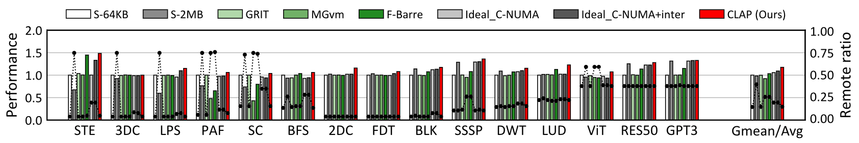
Performance
IPC Comparison
- CLAP improves performance by up to 19.2% compared to prior works
Group A
Group B
Group C
Class | Consideration
 | A: Address Translation (Page Size) | B: Remote Accesses | C: Impact of Page Size
Group A | √ or X | X or √ | X
Group B | √ or X | △ or √ | X
Group C | △ | △ | √
CLAP (ours) | √ | √ | √
41

Slide 43
Summary
Challenges
-MCM designs introduce NUMA effect that can degrade performance
Key Motivations:
- Page size affect NUMA behavior
- Page size sensitivity varies across application
- GPU workloads exhibit strong chiplet-locality
→ Solution: CLAP achieves both (1) higher translation efficiency and (2) strong data locality
The key ideas behind CLAP are essential for sustaining performance scalability
in emerging MCM GPU designs
42

Slide 44
Leveraging Chiplet-Locality for Efficient
Memory Mapping in Multi-Chip Module GPUs
58th IEEE/ACM International Symposium on Microarchitecture
Thanks!
Junhyeok Park Sungbin Jang Osang Kwon
Yongho Lee Seokin Hong

